Slide 1
Chapter 3 Biological Aspects of Psychology
Chapter Review

Slide 2
Important things to know
Features of neurons
Resting and Action potential
Synapses
How neurons communicate
Neurotransmitters
Divisions and subdivisons of the nervous system
Major structures of the brain
Lateralization of the brain

Slide 3
Axon vs. Dendrites: Who carry receive signals from the axon of other neurons and carry them to the cell body?
Dendrites!
Axons carry signals away from the cell body.

Slide 4
What is the fatty substance that wraps around some axons? What does it do?
Myelin sheath
It speeds up action potentials.
People with multiple sclerosis experience loss of myelin sheath

Slide 5
When a neuron is at rest, the inside of the cell is more positive or negative than the outside?
Negative.
Sodium (Na+) is more concentrated outside the cell and tend to move into the cell.
Potassium (K +) is more concentrated inside the cell and tend to move out of the cell.

Slide 6
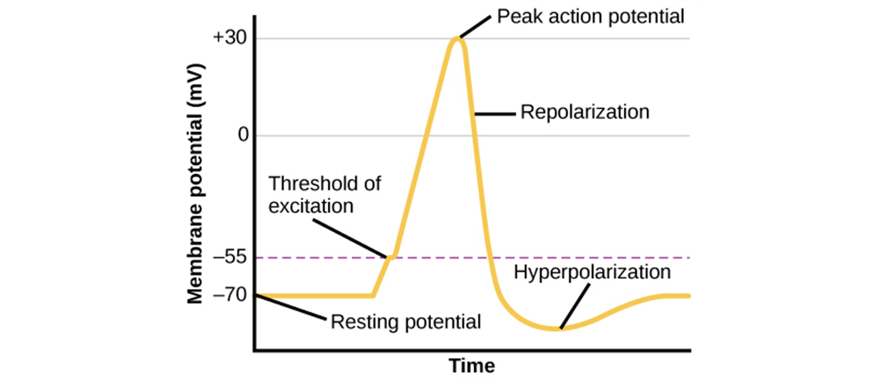
How does an action potential happen?
- Dendrites receive signals
- Sodium gates on the membrane open, allowing Na+ ions to move into the cell.
- Internal charge becomes more positive. If reaches a certain level (threshold of excitation), the neuron fires.
- More gates open, causing a massive influx of Na+ ions to rush in and a huge positive spike in the membrane potential.
- At the peak of the spike, the sodium gates close and the potassium gates open, causing K + ions to leave.

Slide 7
What is the all-or-none law that action potential follows?
The neuron either fires at full strength or it does not fire at all.

Slide 8
What happens when an action potential reaches the end of an axon?
A neurotransmitter is released into the synapse. (Synapse is the tiny gap between neurons.)
The dendrites of the neighboring neurons detect it.
The neurotransmitter and the receptor (if available) bind, creating an electrochemical change in the neighboring neuron.
The electrochemical change makes the next neuron fire or not fire.

Slide 9
Important neurotransmitters
Dopamine.
Serotonin
GABA

Slide 10
The peripheral nervous system is consisted of which two divisions?
The somatic nervous system: transmits information from the senses to the central nervous system (sensory neurons) and carries signals from the CNS to the muscles (motor neurons).
The autonomic nervous system: carries messages between the CNS and the heart, the lung, and other organs.

Slide 11
What is the lateralization of the brain?
The tendency for one cerebral hemisphere to excel at particular function or skill compared with the other hemisphere.
The left hemisphere has better logical and language abilities, whereas the right hemisphere has better spatial, artistic, and musical abilities.

Slide 12
What are two of the major functional areas of the cerebral cortex?
Sensory cortex: receives information from senses
Motor cortex: controls voluntary movements in specific body parts

Slide 13
What information does somatosensory cortex receive?
Somatosensory cortex, along with auditory and visual cortex, make up the sensory cortex.
Somatosensory cortex receives information from the skin about touch, pain, and temperature.

Slide 14
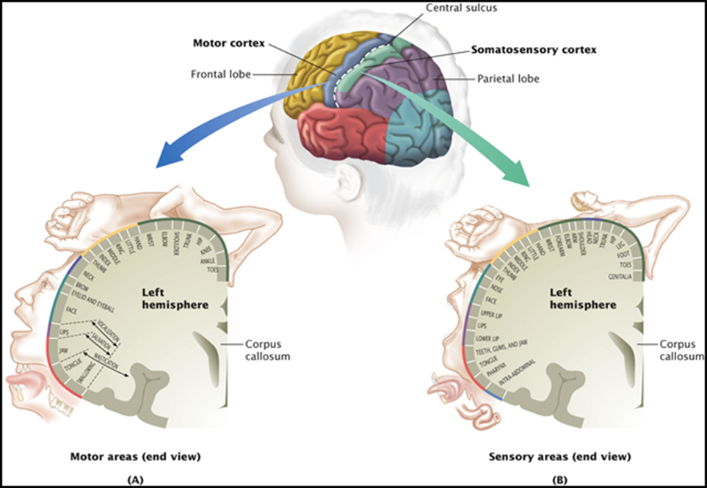

How does the brain feel/guide our body?
The somatosensory homunculus and the motor homunculus mirror each other.

Slide 15
What are the two areas of cerebral cortex related to language? What may happen if these two areas get injured?
Broca’s area: If damaged, people cannot speak fluently and grammatically. But what they say still has meaning.
Wernicke’s area: if damaged, people can speak correctly and fluently. But what they say has no meaning.

Slide 16
Where is the amygdala? What does it do?
Amygdala is in the forebrain (limbic system).
It plays important roles in regulating our emotions, such as fear.

Slide 17
Where is hippocampus? What does it do?
It’s in the forebrain (limbic system).
It is important in the formation of memories.
People with hippocampus damage may have trouble building new memories.

Slide 18
Which part of the brain regulates blood pressure, heart beat, and breathing?
Hindbrain!
Especially medulla.

